Slide 1
Alternative Cell Models
By Michelle Goodman 6/3/2017
Dupont and Goldbeter 1994
Realistic (Based on Koenigsberger)

Slide 2




1. Dupont and Goldbeter 1994
Z
Z
IP₃
IP₃
CICR
CICR
Infinite Store
Y
Y
2 Pool Model
1 Pool Model
$$\frac{∂Z}{∂t}=V_{in}\left(β\right) −V_{2}+V_{3}+k_{f}Y −kZ$$
$$\frac{∂Z}{∂t}=V_{in}\left(β\right) −V_{2}+V_{3}(β)+k_{f}Y −kZ$$
$$\frac{∂Y}{∂t}=V_{2} − V_{3} −kZ$$
$$\frac{∂Y}{∂t}=V_{2} − V_{3}(β) −kZ$$

Slide 3



1. Dupont and Goldbeter 1994
2 Pool Model
1 Pool Model
$$V_{3}=V_{M3}\frac{Y^{m}}{K_{R}^{m}+Y^{m}}\frac{Z^{p}}{K_{A}^{p}+Z^{p}}$$
$$V_{3}\left(β\right)={βV}_{M3}\frac{Y^{m}}{K_{R}^{m}+Y^{m}}\frac{Z^{p}}{K_{A}^{p}+Z^{p}}$$
Meaning of $v_{1}β$ changed

Slide 4
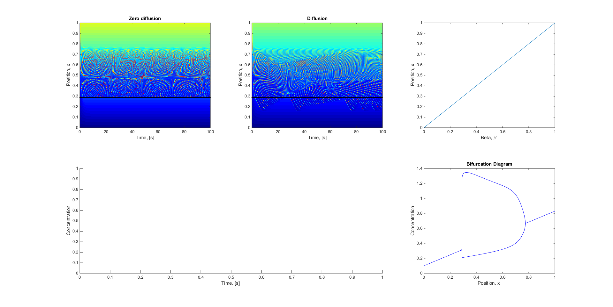

1. Dupont and Goldbeter 1994
2 Pool Model
1 Pool Model

Slide 5
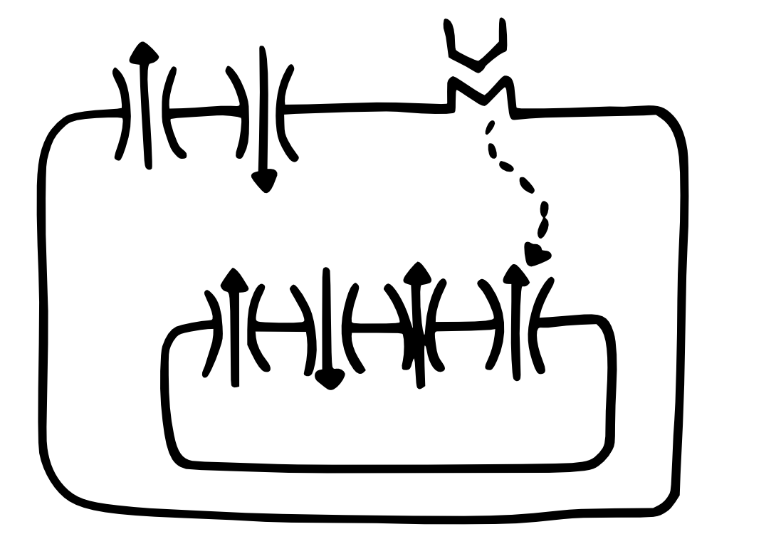



2. Realistic
Constructed by Tim and I
Equations for each channel based on Koenigsberger 2005
J_{ext}
J_{vocc}
J_{leak}
J_{ip3r}
J_{serca}
J_{cicr}
$$\frac{∂Z}{∂t}=J_{VOCC}−J_{ext}+J_{leak}−J_{serca}+J_{CICR}+J_{IP_{3}R}(β)$$
$$\frac{∂Y}{∂t}=−J_{leak}+J_{serca}−J_{CICR}−J_{IP_{3}R}$$
$$\frac{∂V}{∂t}=γC_{m}\left( J_{VOCC}−J_{ext} \right)$$

Slide 6
2. Realistic - Problems
The change in space was not noticeable because beta did not change the external input
I could not get this to oscillate because beta did not change the external input
The membrane potential is not just based on the calcium concentration it is based on all the ionic concentrations
Thus the V we actually calculate is not the true membrane potential
Thus anything that uses the membrane potential to calculate the flux is
incorrect (Ie J_{VOCC})

